Slide 1
ELECTRIC GROWERS SECURITY DEVICE ANALYSIS

Slide 2
DESCRIPTION
Sell security devices.
Analysis using:
1)Segment survey data
2)City population by segments
3)and city-wise demographics data
Notes:
EXPLAIN WHY U WERE HIRED BY THE COMPANY

Slide 3
OBJECTIVES
What type of customers to target.
What cities to target.

Slide 4
TARGET SEGMENTS/CITIES
Approach:
Filtering out necessary features from data.
Normalizing the data to make it in the same scale and prevent any biases.
Using weighted sum to determine a score.

Slide 5
MASS MARKETS,WELL-HEELED AFFLUENTS AND PROSPEROUS ACHEIVERS ARE THE SEGMENTS TO TARGET
Hypothesis: Upper class families that own houses are more likely to purchase
security devices.

Slide 6
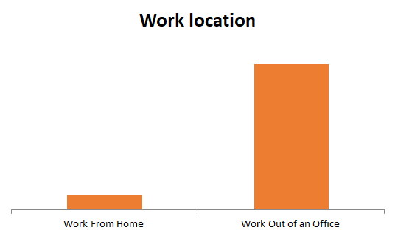
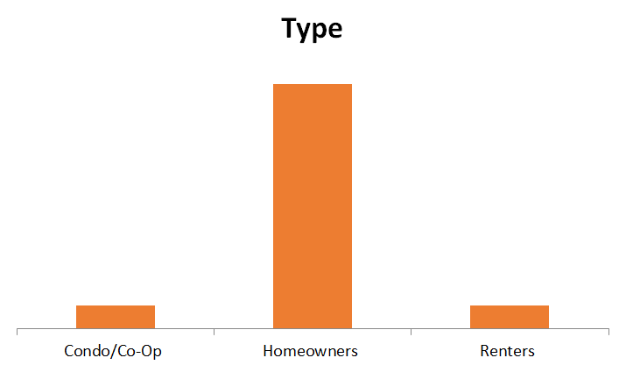
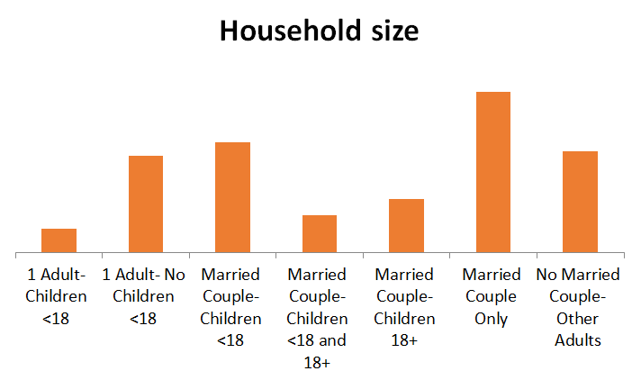
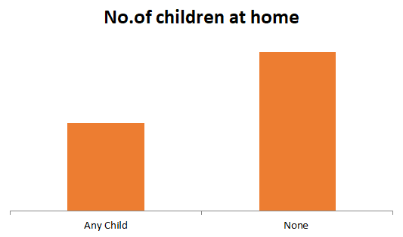
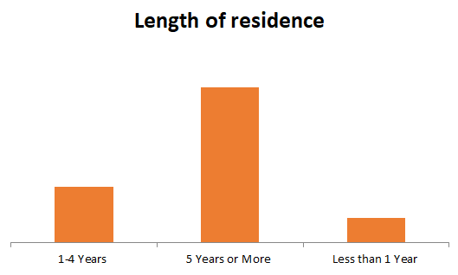
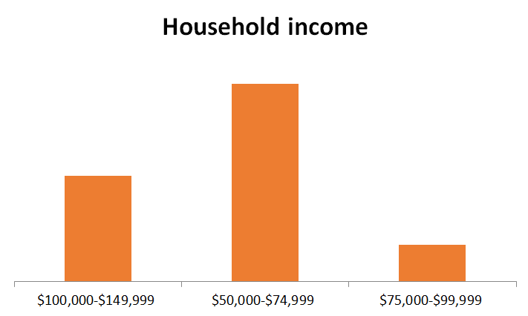
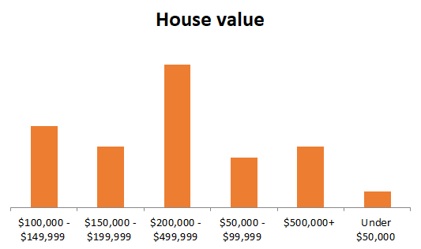
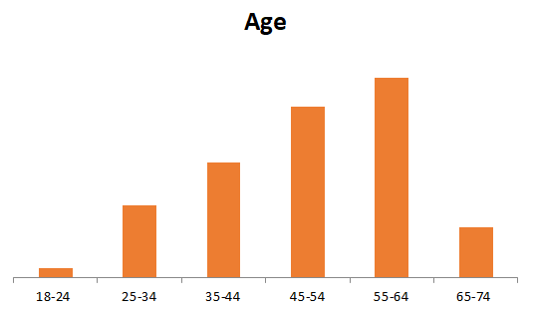
Customer composition

Slide 7

CUSTOMER PROFILE
Age: 45+
Income: $50-80k
Household size: 3-4 people
Type: Homeowners
Status: Couples with/without children
House value: $200,000-$500,000

Slide 8
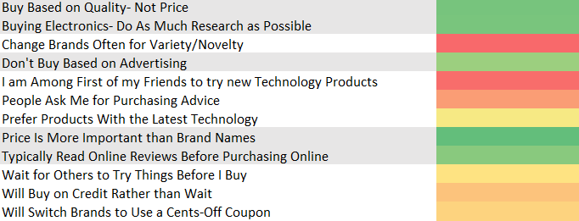
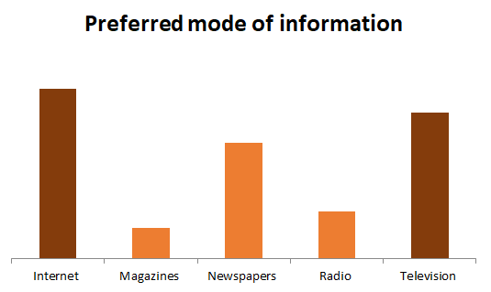
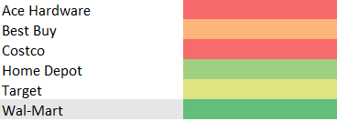
CUSTOMER BEHAVIOUR
Targets sentiment
Retail store
Invest more in online stores rather than retail stores

Slide 9
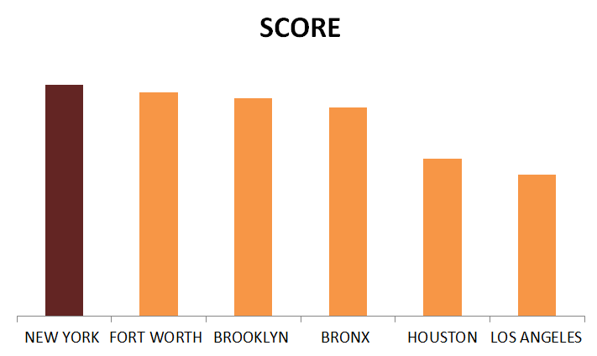
NEW YORK,FORT WORTH,BROOKLYN,BRONX AND HUSTON ARE THE CITIES TO TARGET
Hypothesis: Cities with higher crime rate and burglaries with higher composition of the target segments are more likely to purchase security devices.

Slide 10
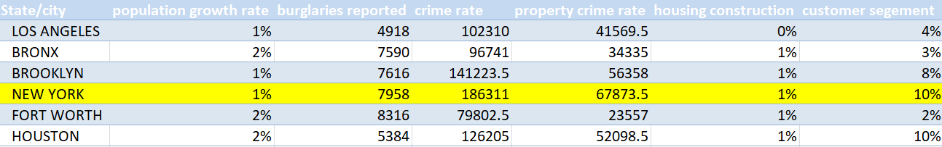
FOCUS ON ENTERING THE NEW YORK AND BROOKLYN MARKET
Based on our analysis New York provides to be the ideal city to target
followed by Brooklyn
3) Houston
4) Fort Worth
5) Bronx/Los Angeles

Slide 11
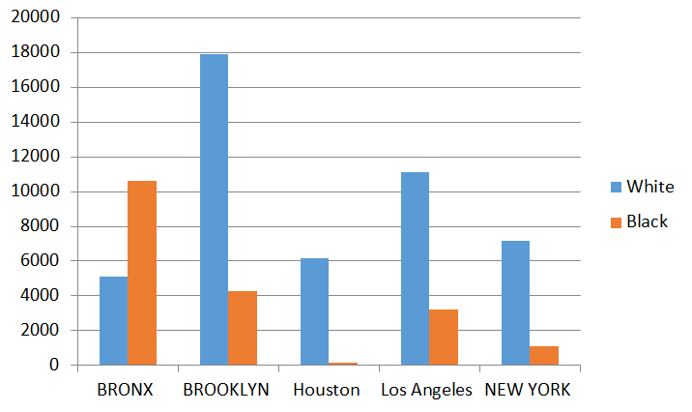
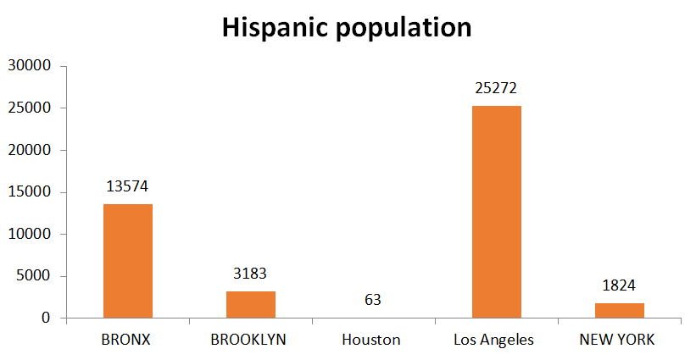
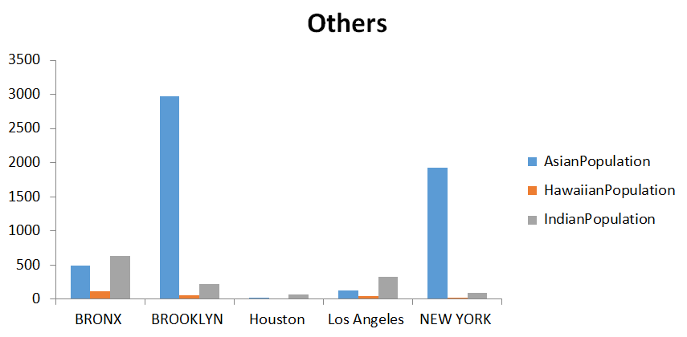
CITY DEMOGRAPHICS
Most of the immigrants are Hispanics followed by Asians and Indians.

Slide 12
SUMMARY
Target customers: 1)Well-heeled affluents
2)Prosperous achievers
3)Mass markets
Target cities: 1)New York
2)Brooklyn
3)Houston
4)Forth Worth
5)Bronx/Los Angeles

Slide 13
THANK YOU!!

